Slide 1

Thapar Institute of Engineering & Technology – Patiala
Manufacturing Processes
UTA026

Slide 2

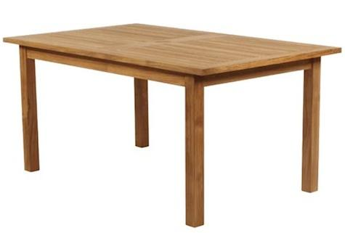
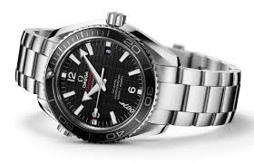
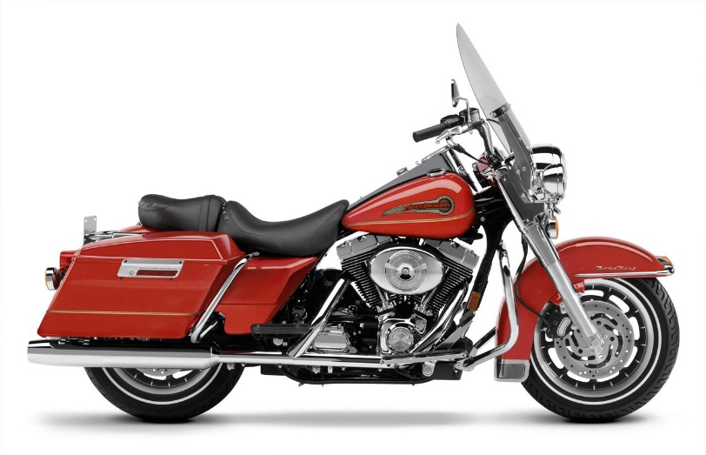

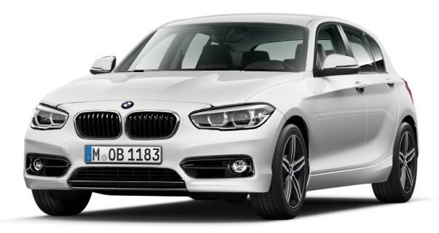

Manufacturing
All of the above products are produced by a combination of various processes called
MANUFACTURING

Slide 3
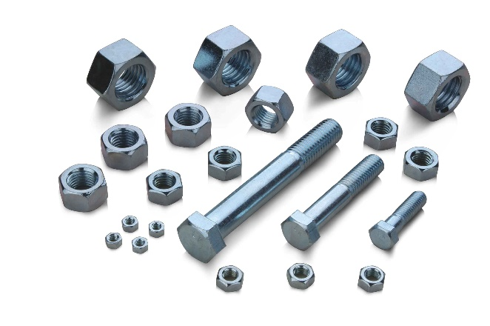
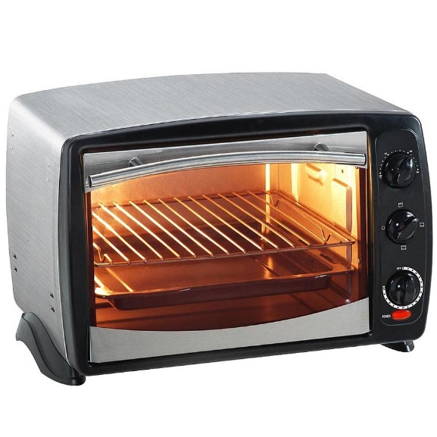
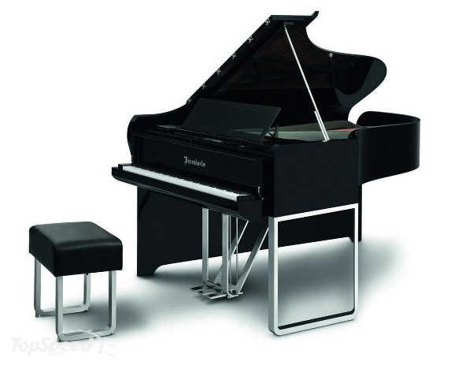

Products & No. of Parts
Single material products
Multi material (parts) products
12,000 parts
>15,000 parts
>6 million parts

Slide 4
What is Manufacturing?
Manufacturing is derived from the Latin: manus= hand, factus=made
Manufacturing in its broadest sense, is the process of converting raw materials into products.
Manufacturing is the use of machines, tools and labour to produce goods for use on a larger scale.

Slide 5


Slide 6
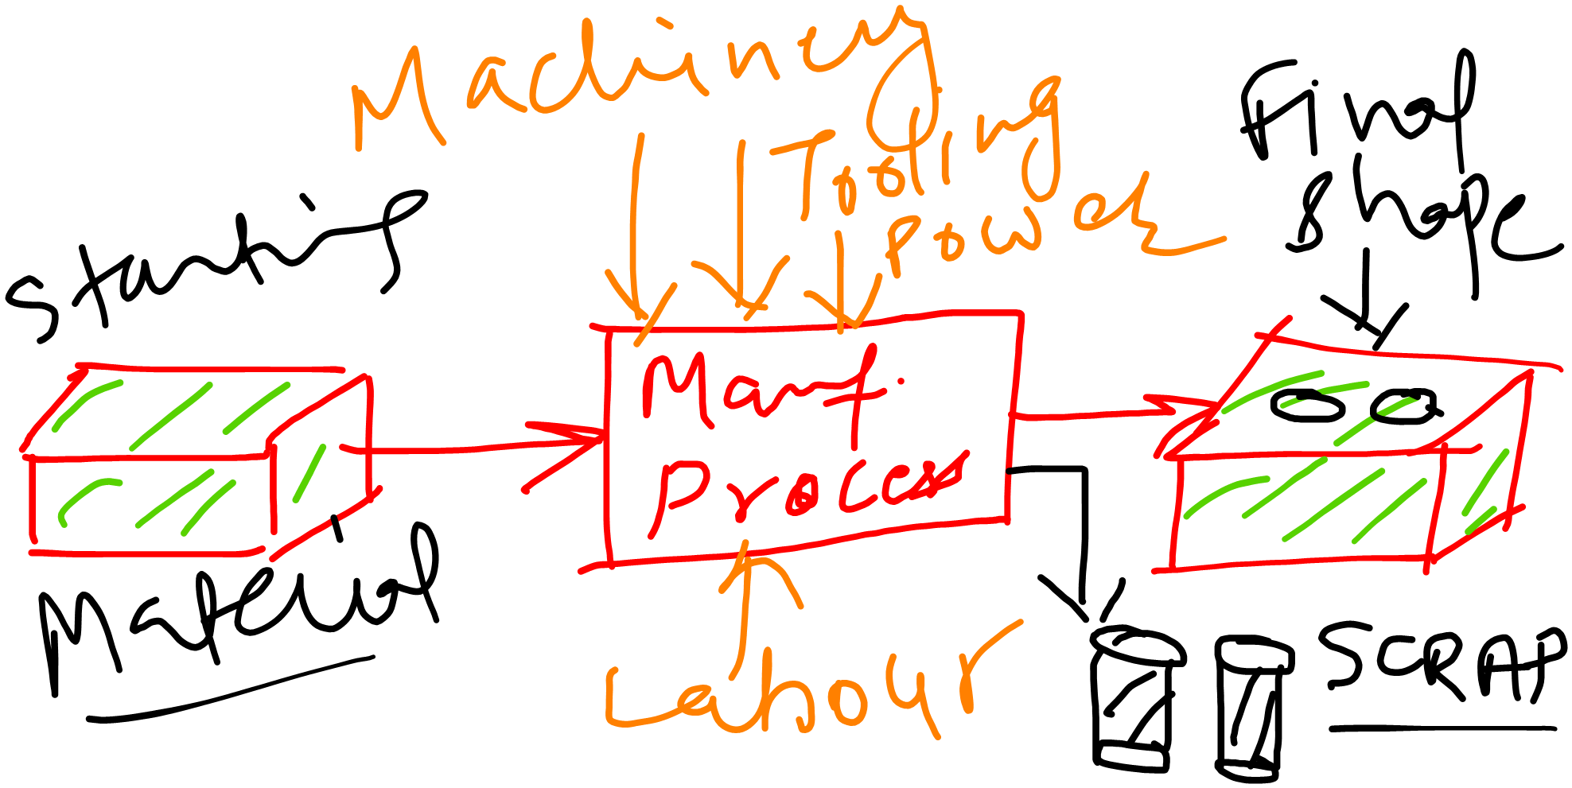

Slide 7
Selecting a Manufacturing Process
Type and nature of the starting material
Expected quality and properties required
Technical viability of the process
Volume of production
Economy

Slide 8
Types of Manufacturing Processes
MACHINING PROCESSES
CASTING PROCESSES
FORMING OR DEFORMATION PROCESSES
JOINING PROCESSES

Slide 9

Machining
Excess material removed from the starting piece so what remains is the desired geometry
Examples: turning, drilling, and milling; also grinding and non-traditional processes

Slide 12

Casting
Starting material is heated sufficiently to transform it into a liquid or highly plastic state
-Examples: metal casting, plastic moulding

Slide 13










Slide 14

Forming
Starting material is shaped by application of forces that exceed the yield strength of the material.
-Examples: (a) Forging, (b) extrusion

Slide 15



Slide 16

Joining
These operations join two or more components to create a new entity
-Examples: (a) welding, (b) brazing, soldering

Slide 18
Thanks!!

